Slide 1


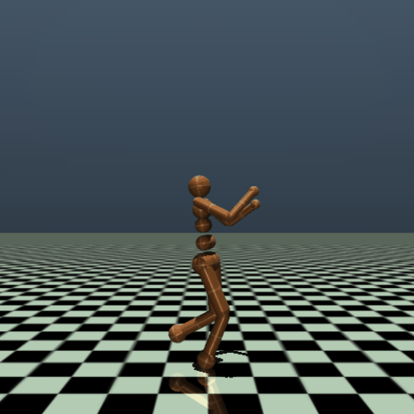
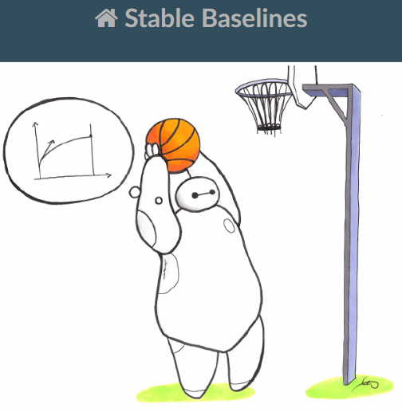
Customizing OpenAi Gym Environment With Sable Baselines Reinforcement Learning Agents
Grupo W
André Sousa 202108571
David Scarin 202108314
Paulo Silva 202107359

Slide 2
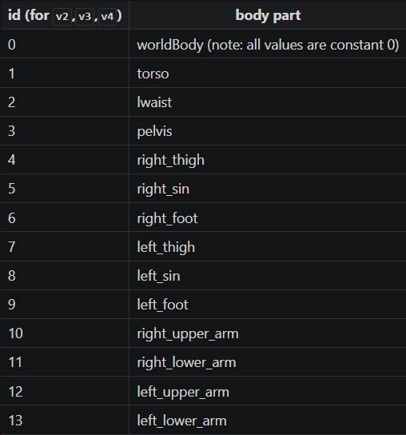
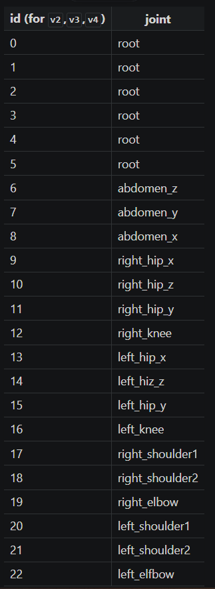
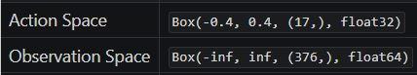
Environment Description

Slide 3
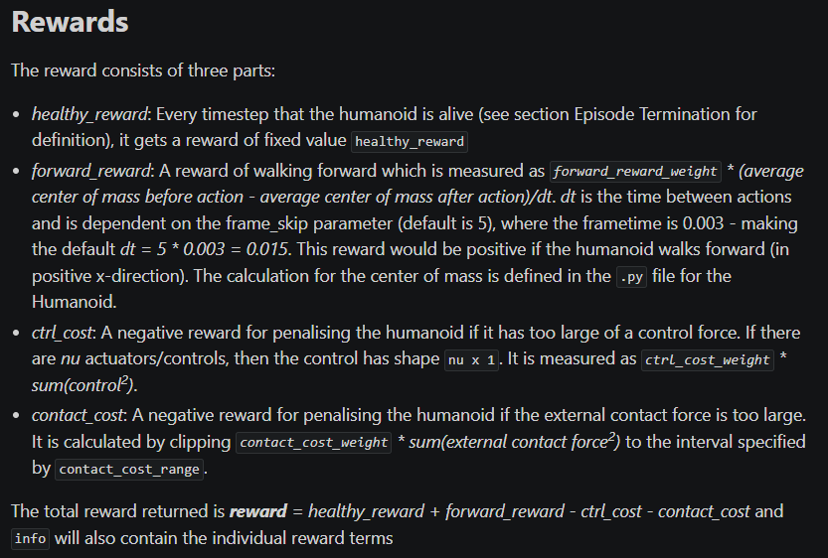
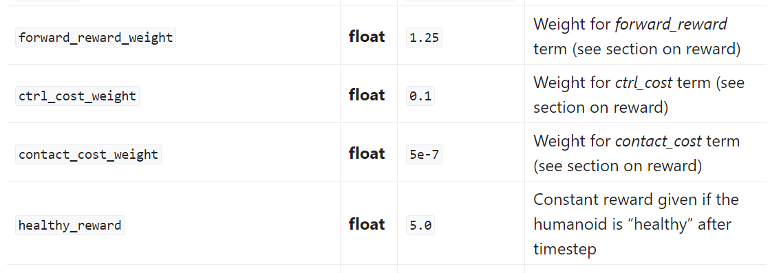
Environment Description

Slide 4
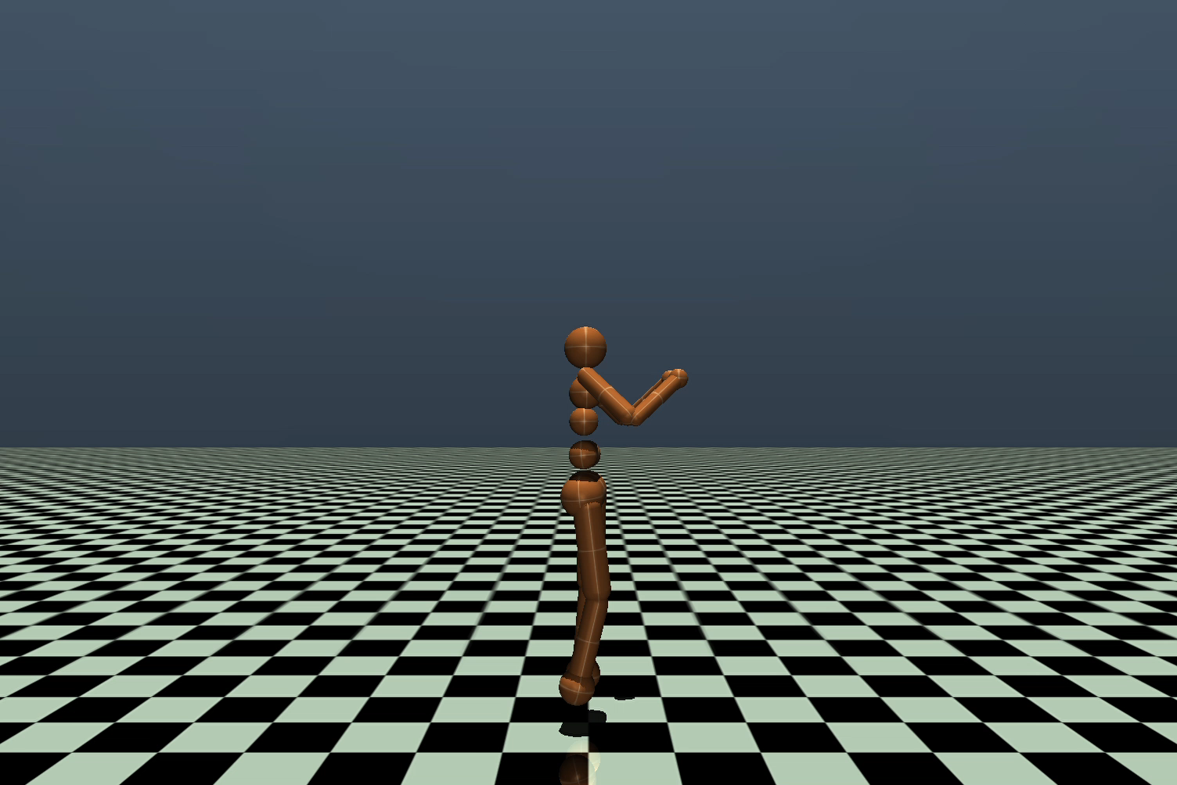
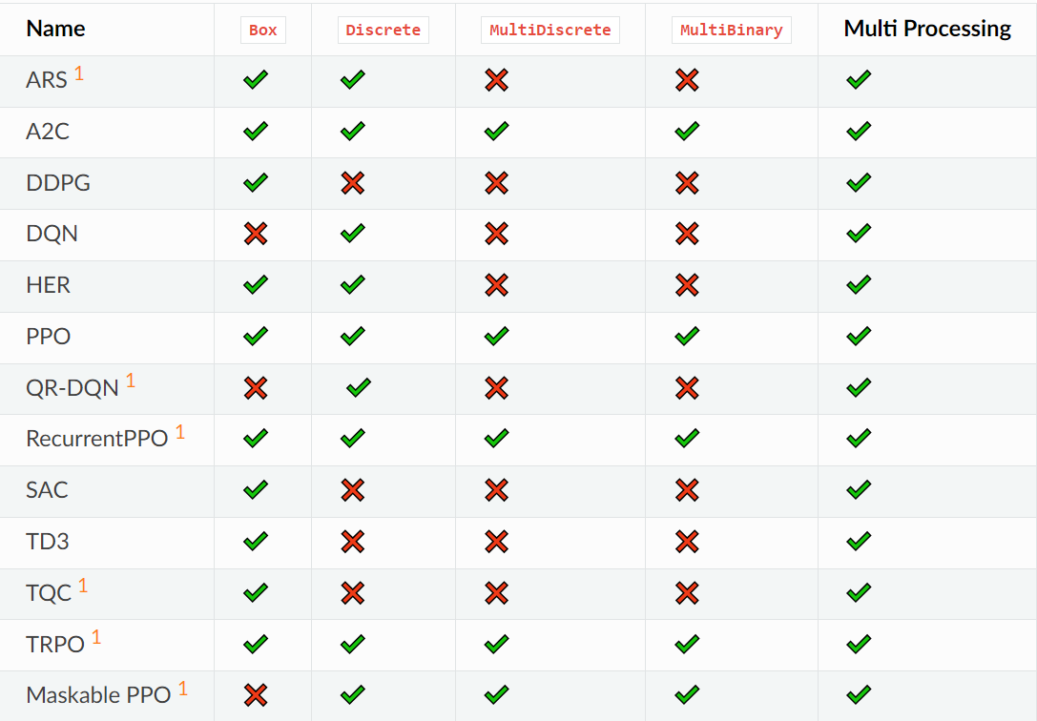
Developed Work
Untrained Agent

Slide 5
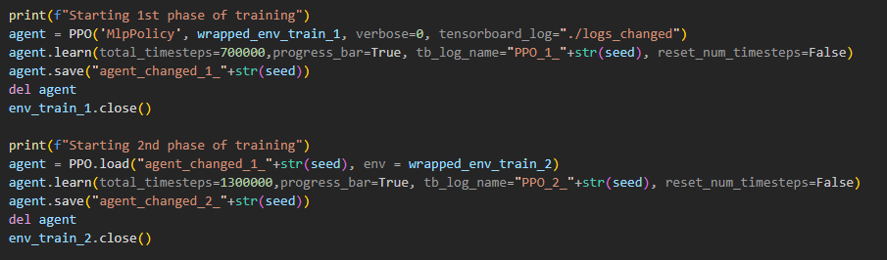
Developed Work
Separate training into 2 phases
Split of 65/35 between first and second phases

Slide 6
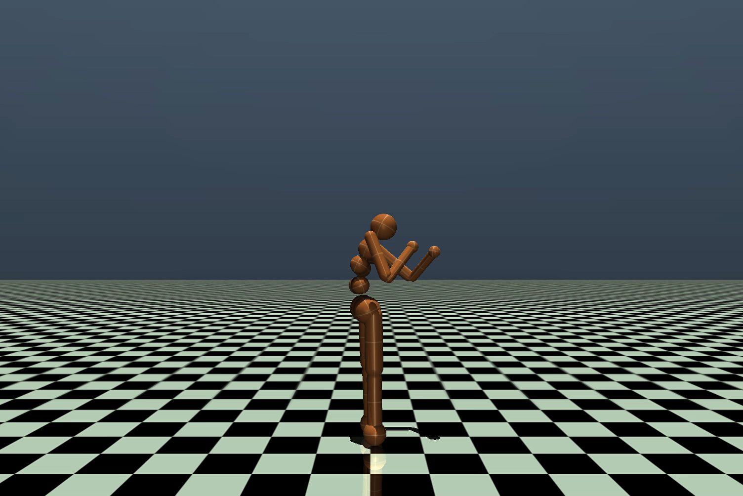
Developed Work
Testing environment
First phase of training with changed rewards
2 training phases with different weights

Slide 7
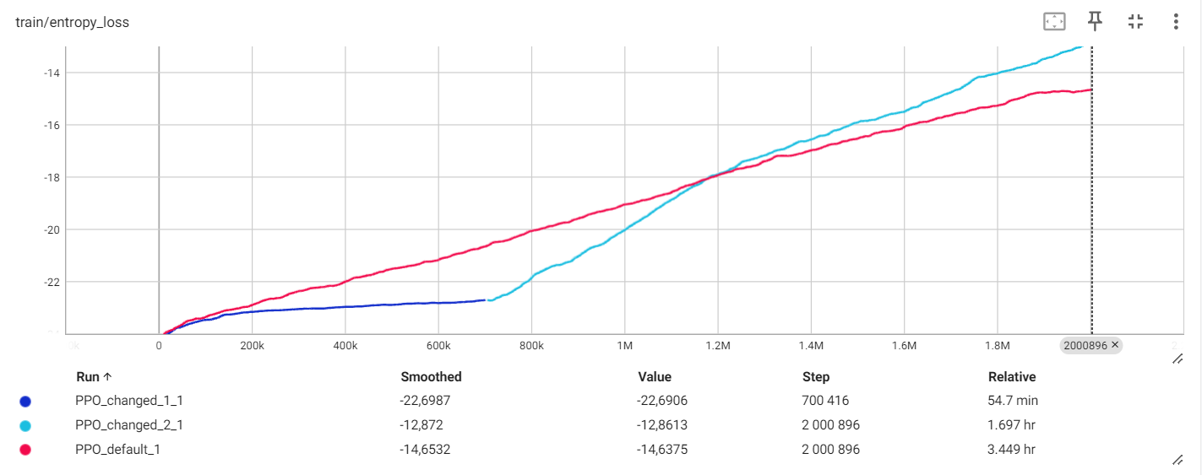
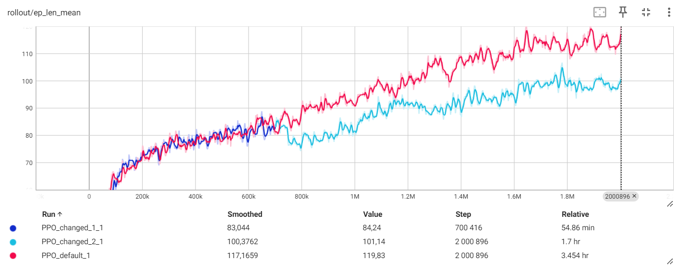
Training curves

Slide 8
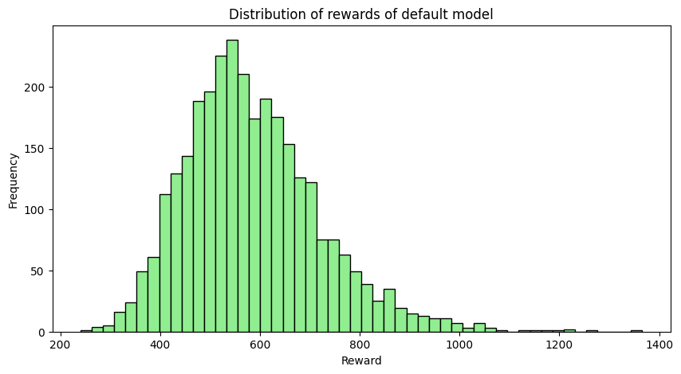
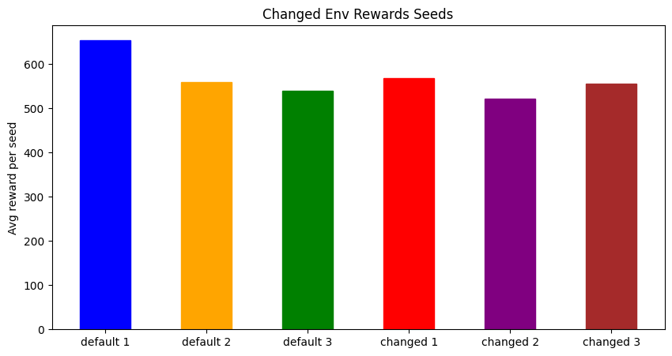
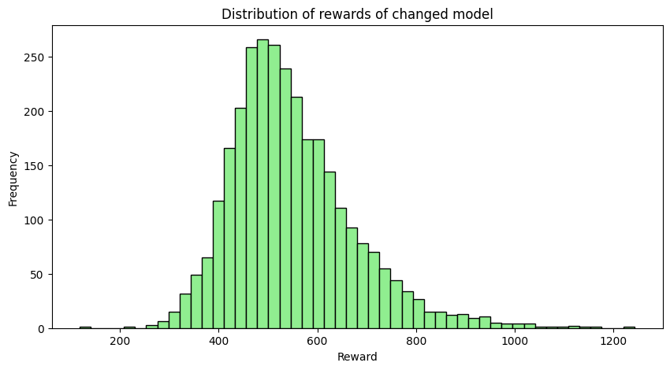
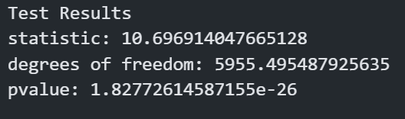
Reward Analysis

Slide 9
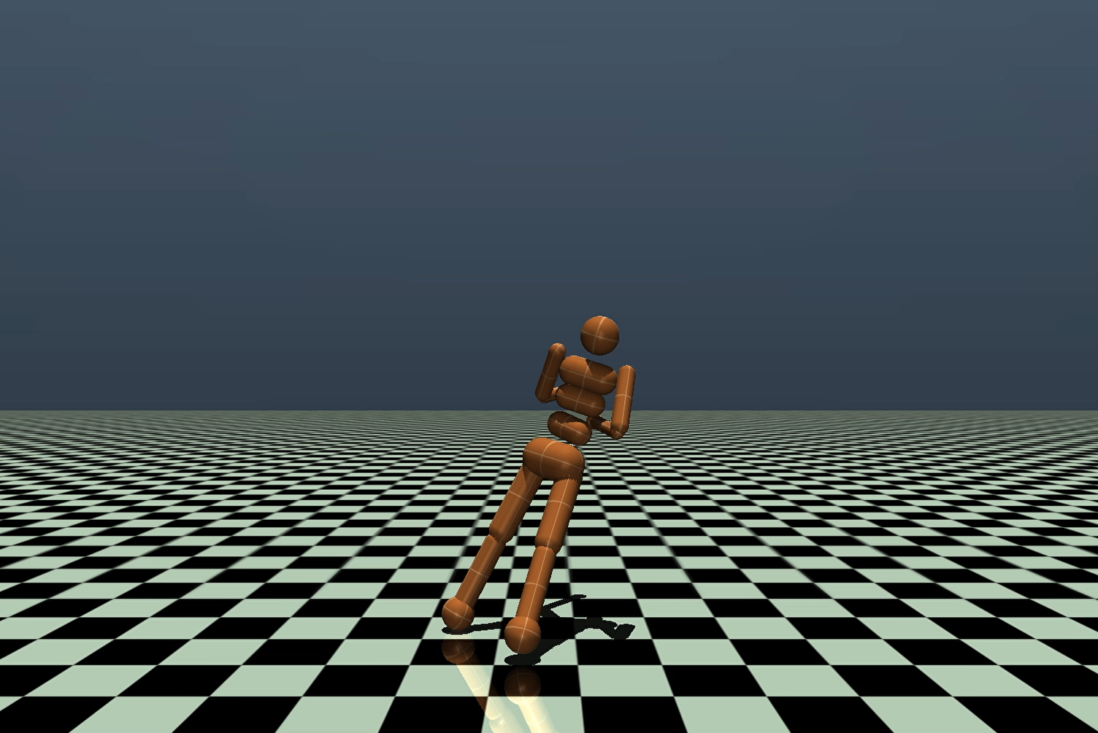
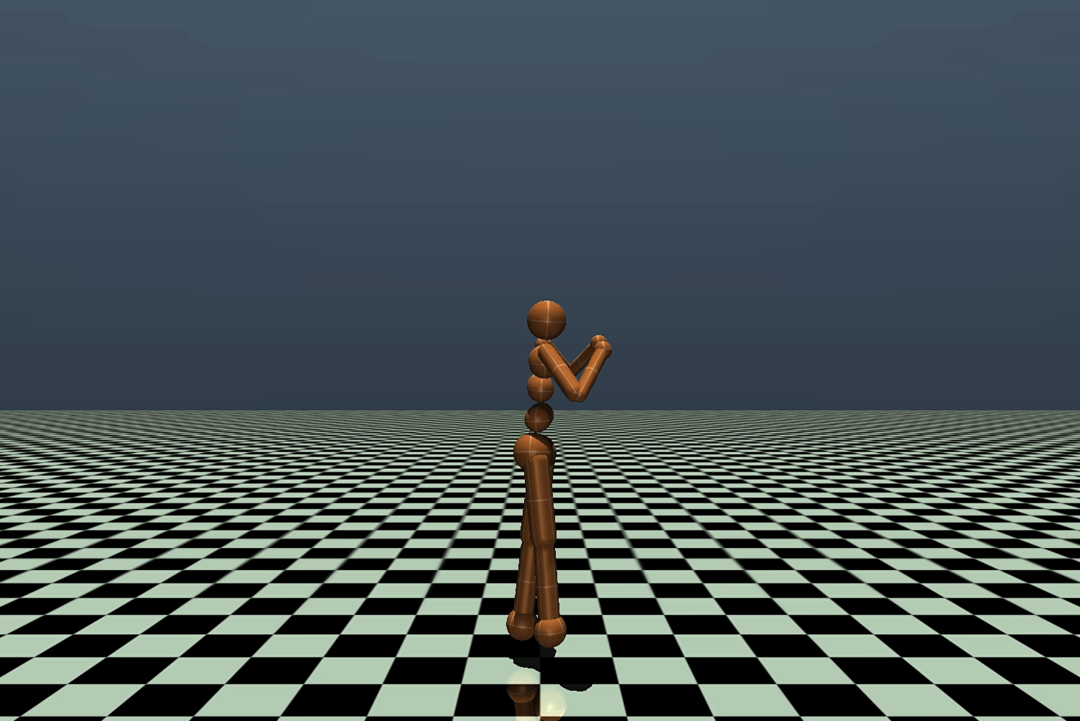
Comparing Results
Agent trained on default environment
Agent trained on changed environment

Slide 10
Conclusions and Future Work
The results return a very low p-value, indicating that there is indeed a significant difference in the means of the two sets of rewards.
Therefore, we can state that there is a difference in the agent trained with or without the custom changes to the environment.
We verify that the agent trained with the default reward settings achieved a better performance for this number of timesteps in training.
However, we can see from the training curves that our changed agent appears to converge faster, so it would be a worthwhile experiment to further train our agents for more timesteps.
Another possible option is to attempt to finetune our learning algorithm by changing parameters such as learning rate and optimizer or even the architecture of the network.

